Slide 1

General Laboratory Safety
Dharmendra Singh
Safety Officer
Office of Laboratory safety and Environmental Health (OLSEH)
www.olseh.iisc.ac.in

Slide 2
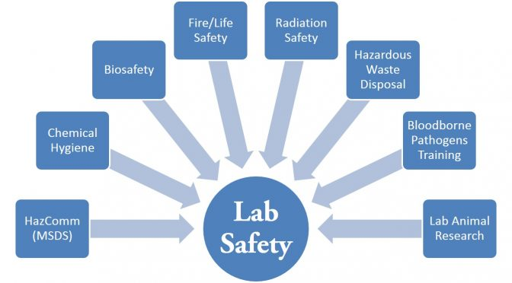
Objectives
Recognize the hazards
Assess the risks of the hazards
Minimize the risks of the hazards
Prepare for emergencies from uncontrolled hazards

Slide 3


Contents
Personal Protective Equipment (PPE)
Safe working practices
Chemical safety
Hazardous waste
Gas safety
Compressed gases
Cryogens
Fire safety
Electrical safety
Laser safety
Radiation Safety
Identify hazards

Slide 4
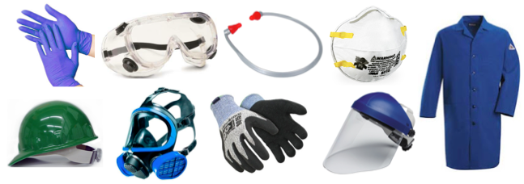
A. Personal Protective Equipments (PPE)
From uvm.edu
Must be worn at ALL times in the laboratory

Slide 5
PPE: Eye Protection Options
Chemical Splash Goggles
Protects from liquid hazards
Needed in any lab that stores chemicals
Safety Glasses
Protects from mechanical and impact hazards
There are no labs in IISc that do not need these
Wear even if you are personally not working with chemicals
Face Shields
Protects from voluminous hazards
Need to be work OVER splash goggles
Must be worn in all other labs
For fuming or extremely dangerous chemicals: HF, liq. N2, etc.

Slide 6
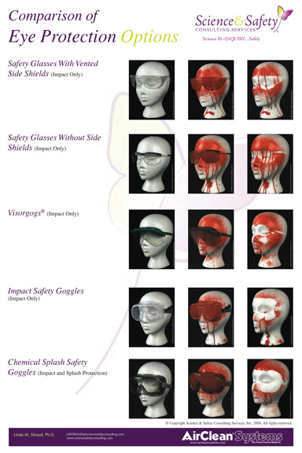
PPE: Eyewear Options
Wear eyewear even if they fog
Get anti-fogging eyewear
Wear eyewear even if you have specs
Get a habit of wearing eyewear ALL times
Before splash
After splash
Eyes are not protected
Eyes are protected
From AirClean Systems

Slide 7
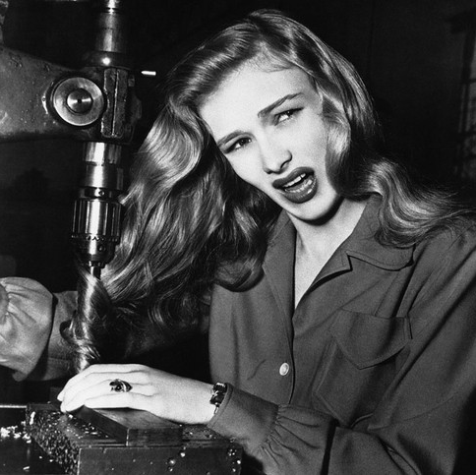
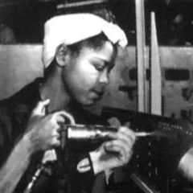
PPE: Nothing Should Dangle
No dangling hair, necklaces, earrings, dupattas
Tie-up hair or use hairnets
Avoid or tie dupattas
From WW2 safety videos

Slide 8
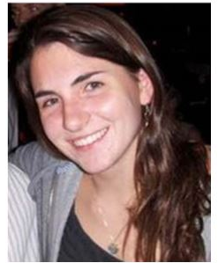


PPE: Long Hair
Dangling hair caused Yale student Michele Dufault who was killed in an accident in April 2011
Her hair got stuck in a drill. A hair tie may have saved her life

Slide 9
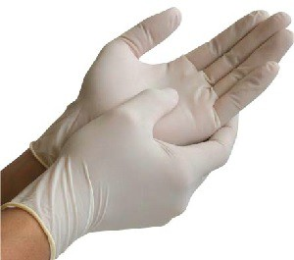
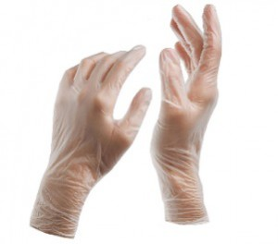
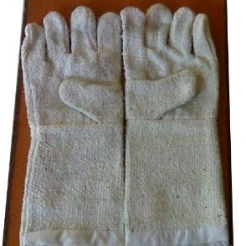
PPE: Gloves
Thin nitrile
Thick nitrile
Heat-resistant silicone
Cryogen gloves
< 2 mil thick
Solvents
Biological samples
Corrosive chemicals
Toxins
Ovens
Furnaces
Hot surfaces
Liquid N2, He, etc.
2-4 mil thick
Acids & bases
General purpose
Not allowed
Latex
Vinyl
Asbestos

Slide 10
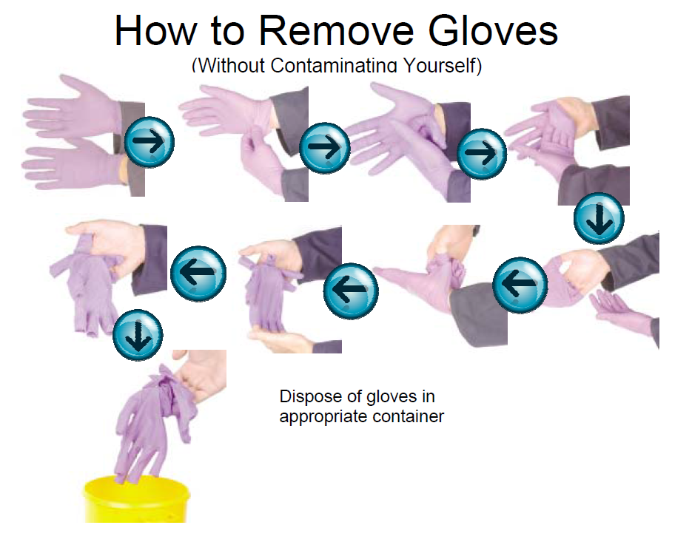
PPE: Gloves – Do and Don’ts
Do
Check gloves for holes or tears
Replace a torn glove
Dispose gloves in lab solid waste before leaving lab
Wash hands after using gloves
Don’t
Re-use disposable gloves
Increased risk for contamination
Continue using a torn glove

Slide 11

PPE: Wash You Hands!
Even if wearing gloves, always wash hands with soap after leaving the lab

Slide 12


PPE: Footwear
No flip-flops, sandals, crocs, or chappals.
Only closed toe shoes
Common violations
Several labs have a "take shoes off" policy.
Some labs use chappals inside lab.
“It is too hot to wear shoes.”
“I was not planning to do lab work today!”

Slide 13

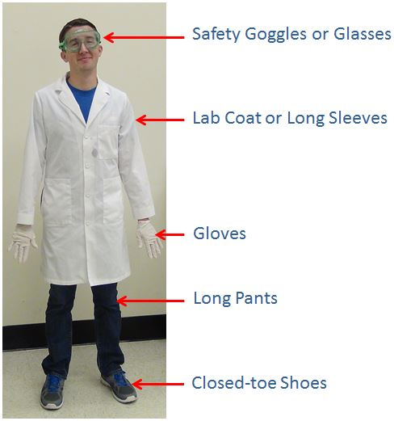
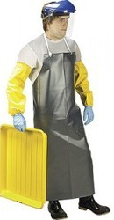
PPE: Summary
Bare minimum
Big hazards
Face shield
Long sleeved thick gloves
Apron
From ehs.virginia.edu
From indiaMART.com
Chemical resistant shoes

Slide 14


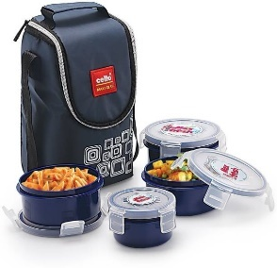
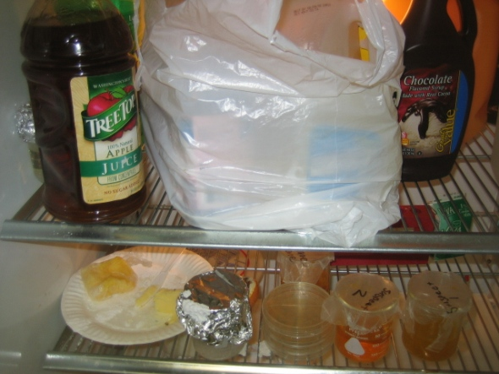

SWP: No Food in Lab
Don’t eat/drink in lab
No chai, coffee
No mugs
No lunchboxes
No chewing
Don’t store food in lab fridge
Not even when packed
Juice + lunch
Lab samples

Slide 15
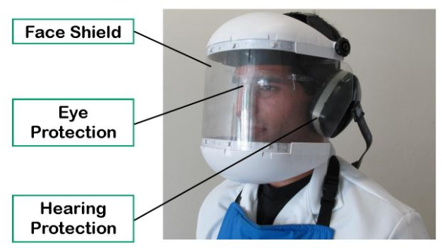
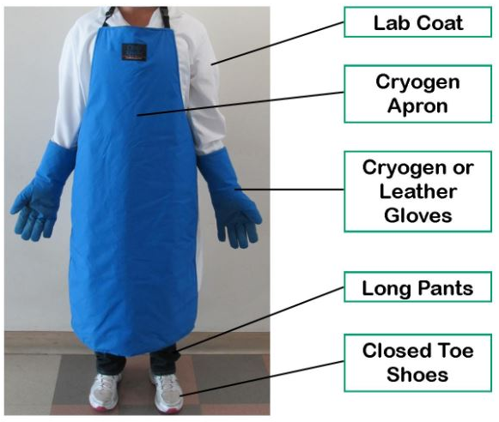
PPE: Working with Cryogens
Mandatory PPE for filling liquid N₂, Ar, and He tanks

Slide 16
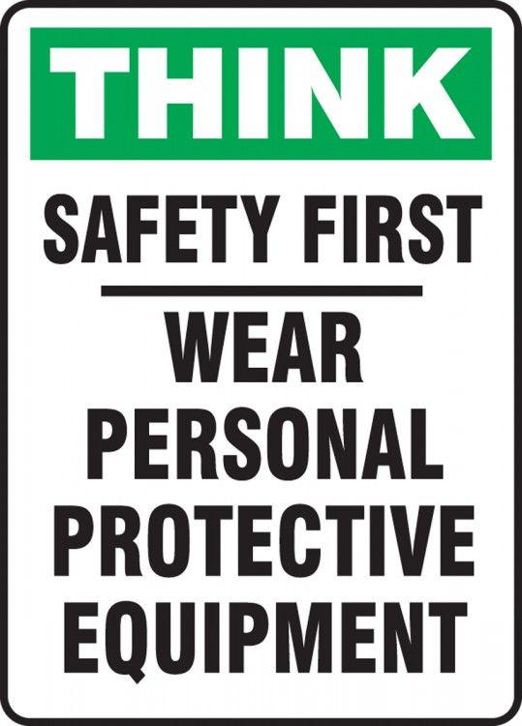


B. Safe Working Practices
Common sense rules that must be followed

Slide 17
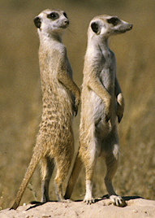
SWP: Never Work Alone
Follow Buddy System
Buddy == another person in lab
Always have a buddy
Especially at night
Friend with a cell phone is not a “buddy”
Look out for each other
If you see something unsafe, point it out
Be professional, don’t take it personally
Look out for another

Slide 18



C. Chemical Safety (CS)
Most common type of hazard and the most preventable one

Slide 19
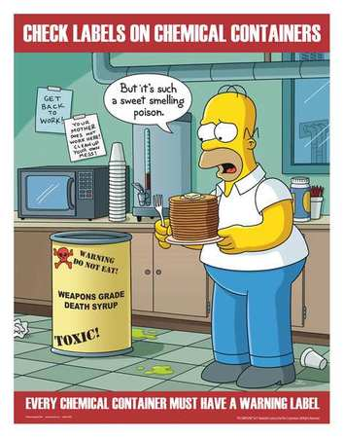
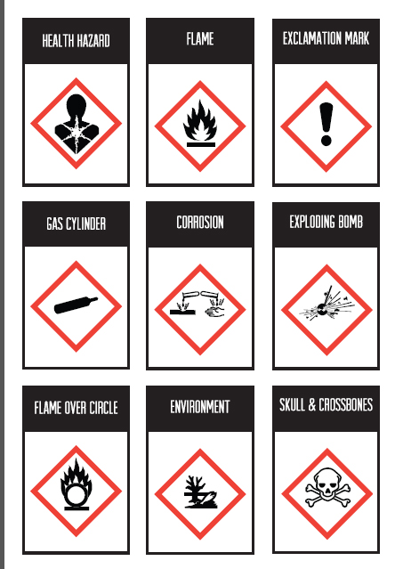
CS: Hazard Labels
Know Standard Hazard Symbols

Slide 20
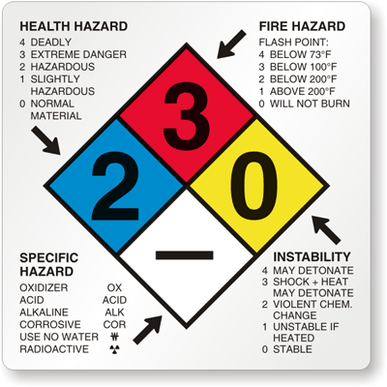


SWP: Material Safety Datasheet (MSDS)
Maintain hardcopy in lab

Slide 21
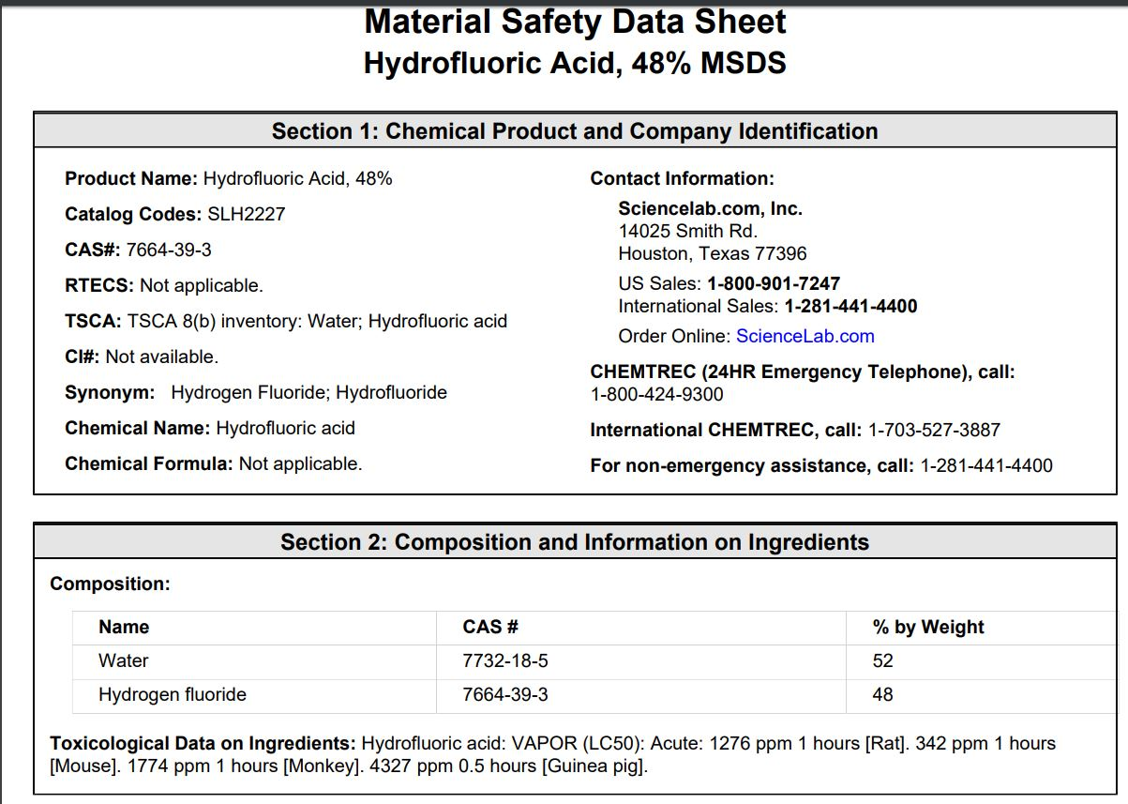

Slide 22
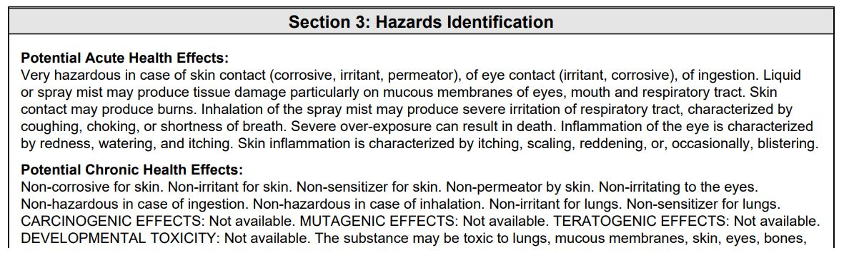
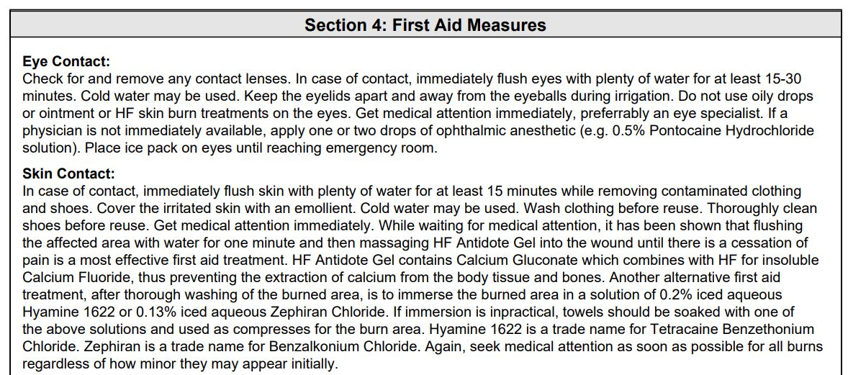

Slide 23
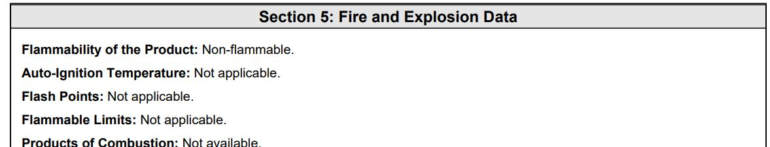
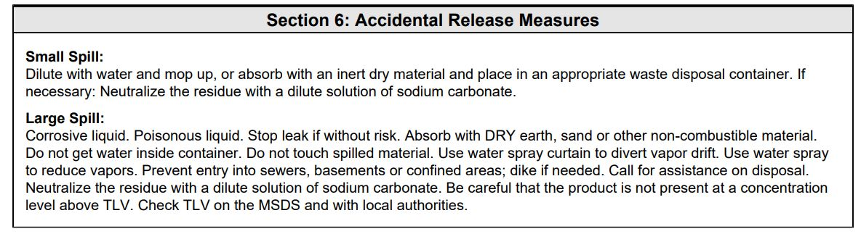
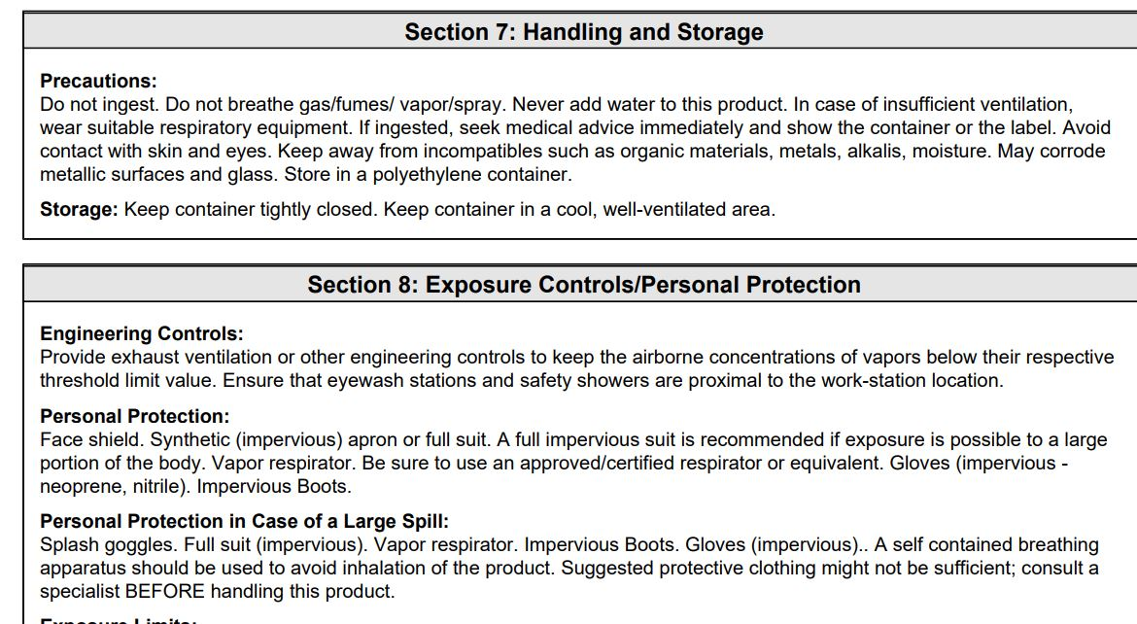

Slide 24
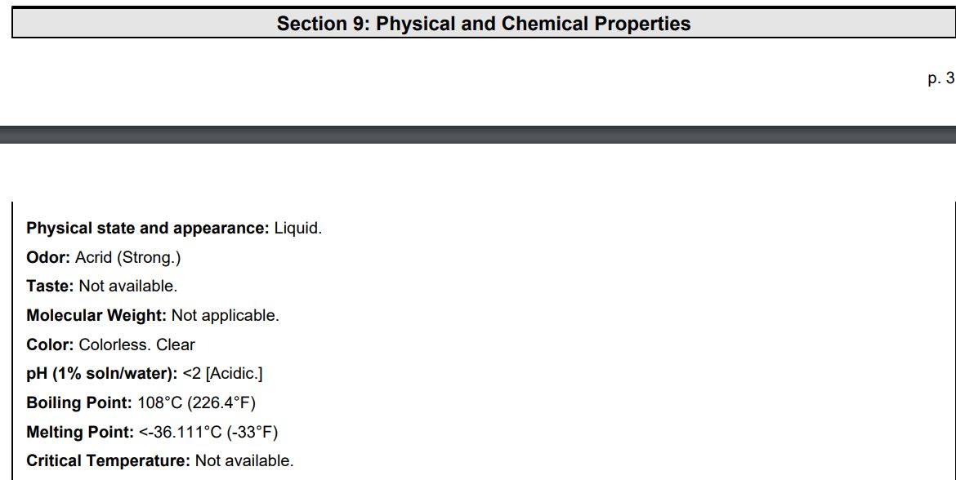
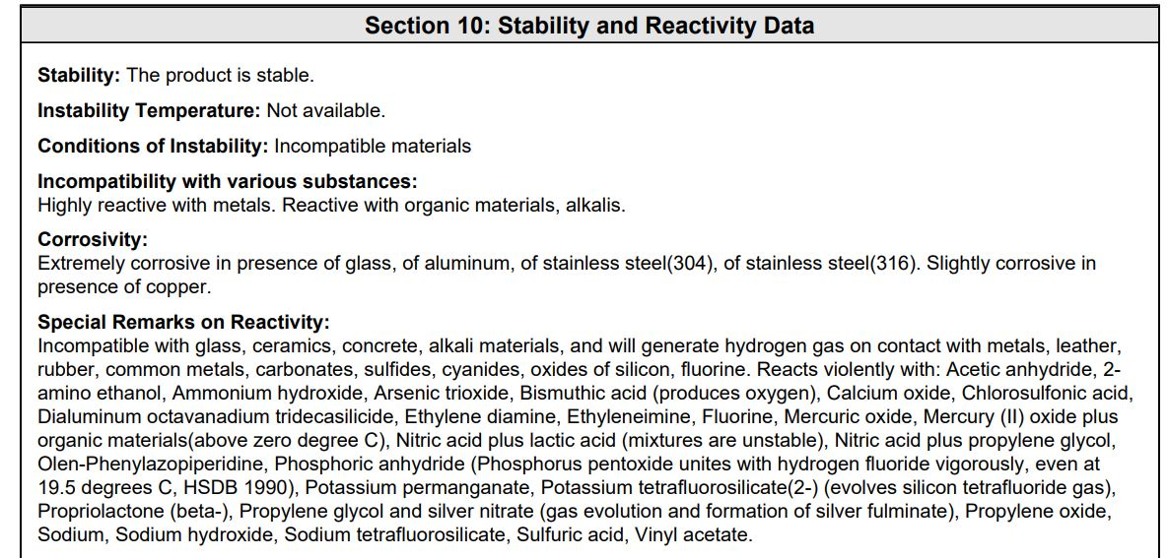

Slide 25
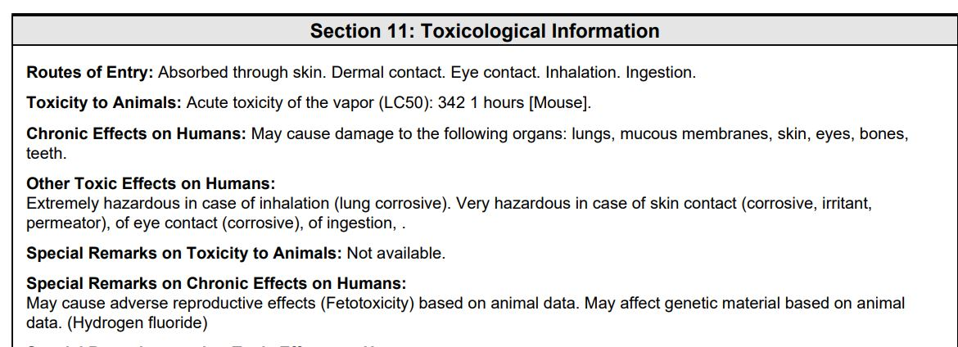
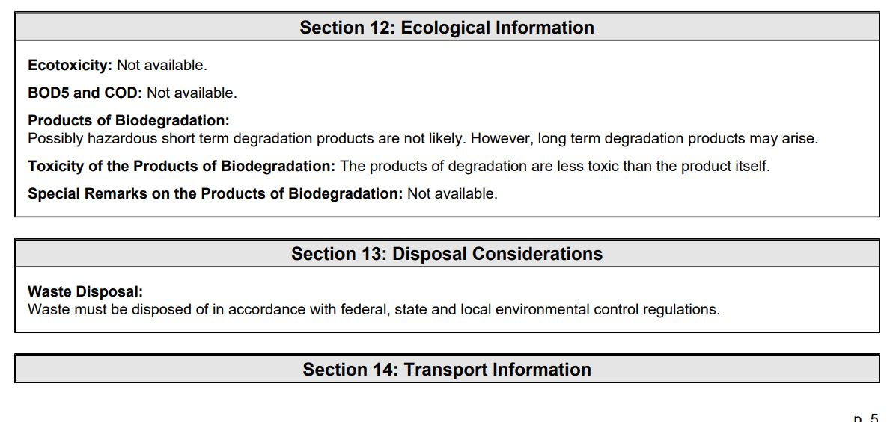

Slide 26
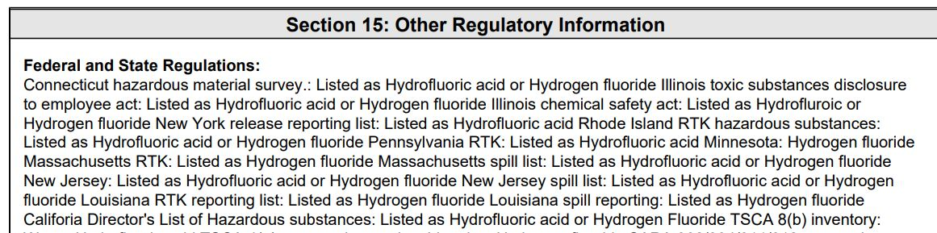
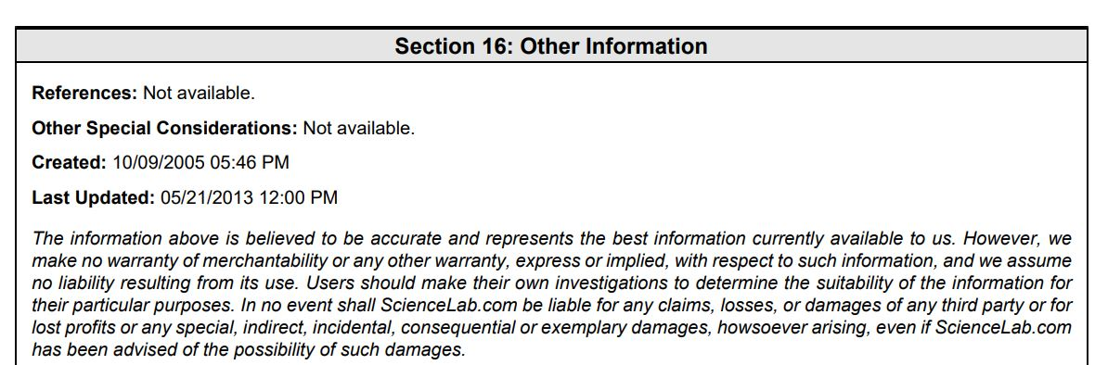

Slide 27
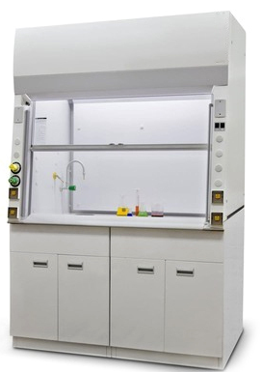
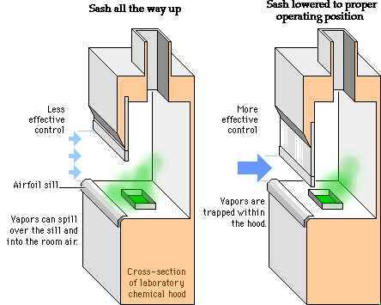
CS: Chemicals Handling
www.tarleton.edu
All chemical processing in fume hoods
Keep the sash as low as possible

Slide 28
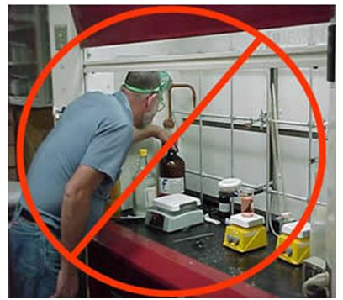
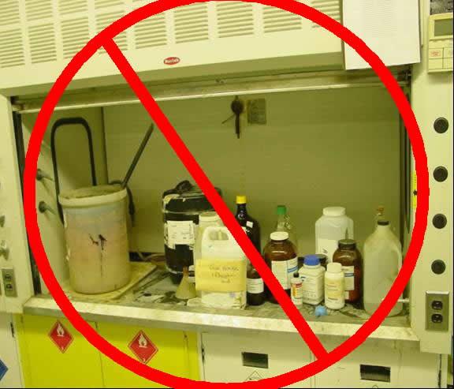
CS: Fume Hoods
From Dow Corning Safety Presentation
From Univ. of Waterloo
Don’t put face or head inside
Hood is not for storage

Slide 29
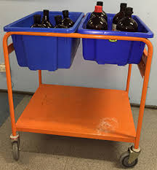
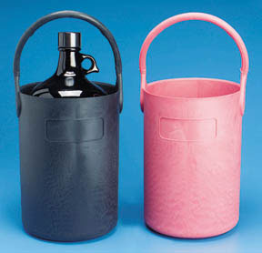
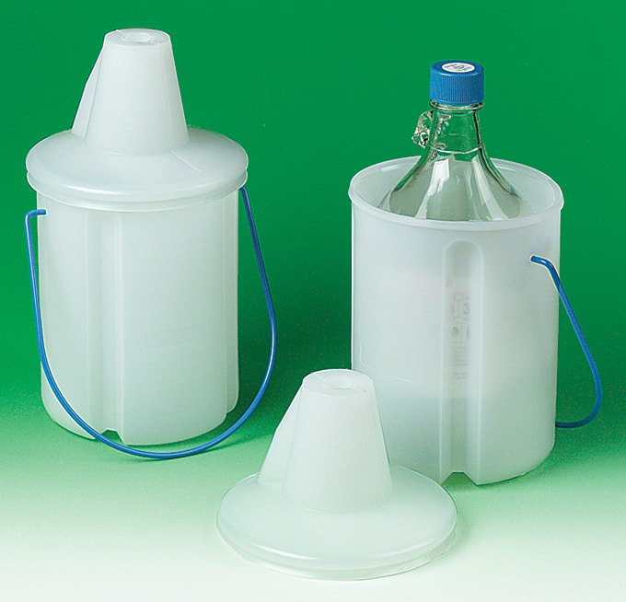
CS: Transporting Chemicals
Don’t carry chemicals with hands.
Hazard to you and others
Use bottle carriers, carts with trays, buckets, etc
Avoid glass bottles

Slide 30
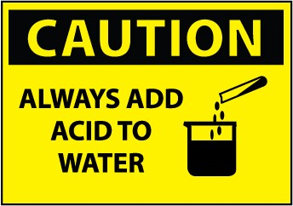
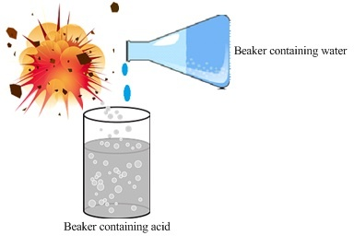
CS: Always Add Acid to Water
Dilution of concentrated acid releases a lot of heat
Adding water to conc. acid releases this heat violently
Acid can splash out of the container and onto your face
Always add conc. acid to water
Else
Acid may splash out explosively

Slide 31
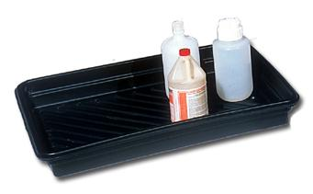
CS: Storage
Exhaust
Separate storage for acids; oxidizers; and bases & solvents
Acid + solvents are explosive
Acid + base is exothermic
Oxidizers help combustion
At the very least use secondary containment
Chemicals stored in rated cupboards.
Not wooden shelves
Large solvent cupboards are exhausted
Acids
Solvents & Bases
Option 1
Oxidizers
Toxins
Secondary containment
Exhaust
Acids
Solvents & Bases
Option 2
Oxidizers
Toxins
Segregated chemical storage

Slide 32
HW: Spill Response
Neutralizing kits
10-50 ml of spill
For large spills, 0.1 to 50 litres
Only by trained staff
Affected lab to be evacuated
Experienced student or staff
Large spill kits
Area must be barricaded and labelled
Emergency evacuation
For significant toxic, explosive or fire hazards
Evacuate building
Trip fire alarm

Slide 33
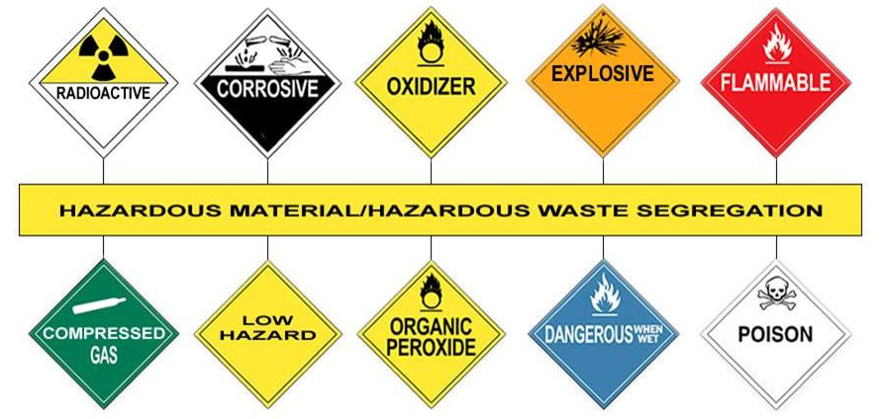
D. Hazardous Waste (HW)
Don’t cook unknown soups
There is no common method of disposal

Slide 34
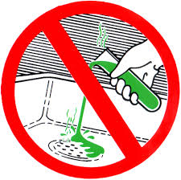
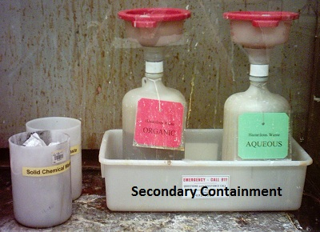
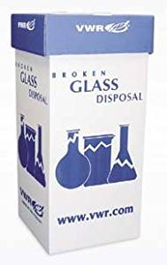
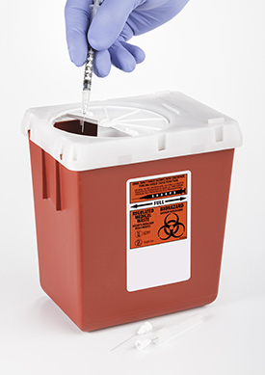
HW: Segregation
Don’t throw chemicals in sewage (pH<4 or pH>10)
Accumulate segregated waste in plastic containers
Waste collected every month. For free
http://ipc.iisc.ac.in/chem_waste_pickup.php
Unknown waste is NOT accepted
Most segregated and labelled waste is accepted
From ehs.uci.efu
No chemicals down sewage
Closable funnels
Organic
Acid
Solid waste
From CU Boulder
No glass in trash
No sharps in trash

Slide 35
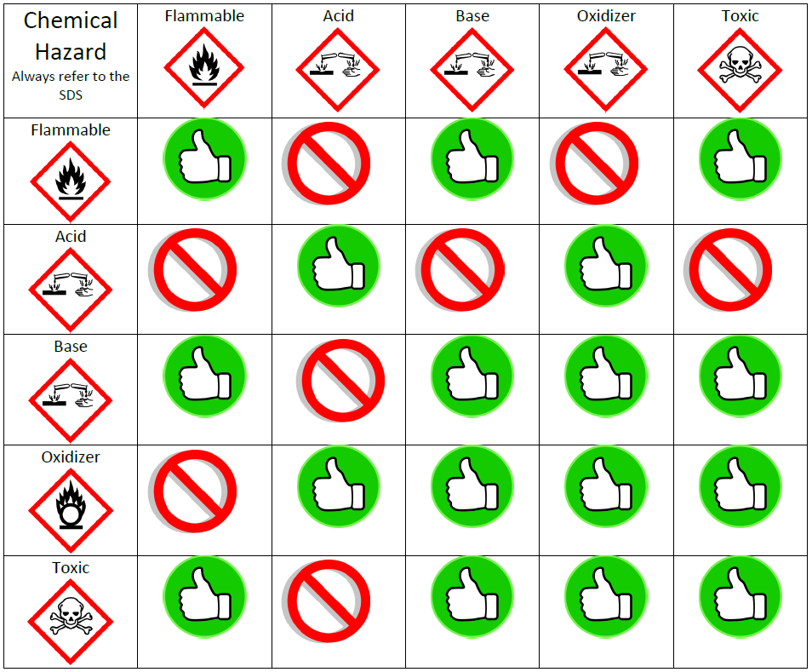
Chemical Waste Compatibility
From ehs.virginia.edu

Slide 36
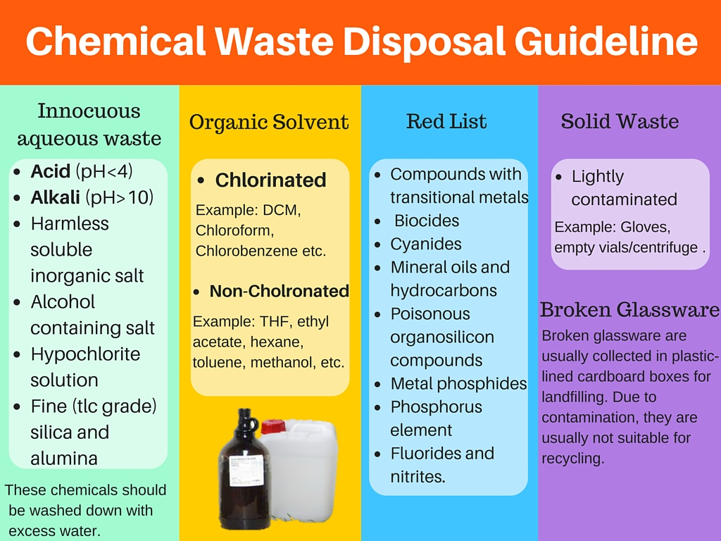
From Wikipedia.org

Slide 37
HW: BioWaste
Solid bio-waste
Napkins, blood-stained wipes, etc.
Same as sanitary waste
Sharps
Syringes, needles, etc.
Sharp boxed labelled bio-waste
Wet waste
Blood or tissue/bacteria cultures
Diluted with 0.5% sodium hypochlorite solution & disposed down the drain
Carcasses
Dead rats, animals, etc.
Store in dedicated freezers
Dispose separately

Slide 38


Cardboard?
No cover
No label
Poor upkeep

Slide 39

LABEL YOUR CHEMICAL WASTE
Wikipedia.org

Slide 40



E. Gas Safety (GS)
Chemical hazard combined with high-pressure hazards

Slide 41



GS: Hazards
Hazard | Gasses
Compressed inert gas | N₂, Ar, He, CO₂
Flammable gasses | H₂, CH₄, C₂H₆, C₂H₂, LPG
Oxidizers | O₂, N₂O
Toxic | CO, H₂S, BCl₃, B₂H₆, Si₂Cl₂, GeH₄, NH₃
Pyrophoric (instantly catches fire in air) | SiH₄, PH₃,
Compressed gasses
Hazardous gases
additional
Gas detectors
Gas cabinets
Orbital welded fittings

Slide 42






GS: Cylinder Handling
Cylinders must be transported on carts.
Not “rolled”
All cylinders must have tags
2/3
1/3
In-use cylinders must be chained
At least mention gas name & use-status

Slide 43


SWP: Cylinder Storage
Full
Empty
Segregate empty and filled cylinders

Slide 44


SWP: Cylinder at Point-of-USe
5m
Electrical box
Door
1m
1m
window
2m
Open drain
Regulator and valve guard
All cylinders must be used with correct regulator and valve guard
Cylinder must be placed in lab with enough exclusion zone around it.

Slide 45





GS: Cryogens
Steel dewars
Glass dewars
Cryo-rated PPE
Compressed cylinders

Slide 46
A Tale of Liquid Nitrogen Tank that Exploded
Safety Report:
The cylinder was standing at one end of a ~20' x 40' laboratory on the second floor of the chemistry building. It was on a tile covered 4-6" thick concrete floor, directly over a reinforced concrete beam. The explosion blew all the tile off the floor for a 5' radius around the tank turning the tile into quarter sized pieces of shrapnel that embedded themselves in the walls and doors of the lab. The blast cracked the floor but due to the presence of the supporting beam, which shattered, the floor held. Since the floor held the force of the explosion was directed upward and propelled the cylinder, sans bottom, through the concrete ceiling of the lab into the mechanical room above. It struck two 3 inch water mains and drove them and the electrical wiring above them into the concrete roof of the building, cracking it. The cylinder came to rest on the third floor leaving a neat 20" diameter hole in its wake. The entrance door and wall of the lab were blown out into the hallway, all of the remaining walls of the lab were blown 4-8" off of their foundations. All of the windows, save one that was open, were blown out into the courtyard.
-- University of Texas at Austin
Blogs.sciencemag.org/pipeline

Slide 47

No tags
No restraint
IPC Lab 2018

Slide 48






F: Fire Safety (FS)
Fire: the combustion reaction from interaction of HEAT + FUEL + OXYGEN
Remove any one and fire cannot spread

Slide 49

FS: Stages of Fire

Slide 50


FS: First Extinguishers
All labs must have them in clearly marked places
One for each class of hazards (see next slide)
They expire. Make sure to refill/service them
Typically need service every 3 years.
Learn how to use them. Very cheap to organize practical training on test fires

Slide 51


Slide 52


FS: Fire Response
Trigger fire alarm
Shout
“FIRE FIRE FIRE FIRE”

Slide 53

FS: Fire Response
Prepare and display an emergency exit plan
Always know the nearest exit
There should be clear signage for all fire exits

Slide 54
FS: Fire Response
All buildings should have designated assembly points
Go to assembly area.

Slide 55

FS: Fire Response
Only listen to a designated emergency response team
Don’t go for coffee. Stay in assembly area
We may need a headcount

Slide 56


FS: Fire Safety Planning
ERT Composition
All departments should have a defined Emergency Response Team (ERT)
Among permanent faculty and staff
Typical roles/actions of ERT:
Respond to fire/emergency
Ensure the labs have been evacuation
Man assembly areas
Take attendance
Call fire-station, security cell, ambulance, etc.
ALL incidents (big or small) must have a incident report.
For evaluation and posterity
Incident Report
Organize regular mock drills.

Slide 57


G. Electrical Safety (ES)
Grounding, insulation, phase matching, and electrical distribution system

Slide 58





ES: Electrical Hazards & Steps for prevention
1. Replace any worn-out or stripped wires
2. Only use 3-pin plugs
3. Earth all equipment
4. Power strips
Avoid them
Use power strips with fuse
Calculate the load

Slide 59






ES: Electrical Hazards & Steps for prevention
6. No water in vicinity
5. No trip hazard
7. No wet hands
8. Don’t pull cord
9. Don’t poke power sockets
No jugaad please
10. Switch off

Slide 60



H. Laser Safety (LS)
Exposure to laser light can cause significant damage to the skin and eyes – typically in the form of burns and direct damage to the retina.

Slide 61




LS: Hazard from Laser
Exposure to laser light can cause significant damage to the skin and eyes – typically in the form of burns and direct damage to the retina.
Injury can be from direct, specular (reflected) of diffuse radiation
Direct

Slide 62

Class | Procedure | Training | Eye Exam | Energy | Hazard
1 | Not Required | Not Required | Not Required |  | Non-hazardous to eye
1M | Not Required* | Not Required* | Not Required |  | Hazardous with collecting optics
2 | Not Required | Not Required | Not Required | < 1mW | Hazardous only when person overcomes aversion response
2M | Not Required* | Not Required* | Not Required |  | Hazardous with collecting optics and/ Class 2 hazard
3R | Not Required | Not Required | Not Required | 1 - 5mW | Hazardous when person overcomes aversion response or uses optics
3B | Required | Required | Suggested | 5 - 500mW | Direct beam eye hazard. No serious injury from diffuse reflection to eye or to skin
4 | Required | Required | Suggested | > 500mW | Hazard to eye & skin from direct, specular or diffuse reflection. Fire hazard
ONLY VALID FOR VISIBLE RADIATION

Slide 63

LS: Effect of wavelengths of laser
Retina damage is often permanent and irreparable.
Cornea and lens damage can heal, although the injury is incredibly painful.
Corneal/lens damage
Retinal damage
Corneal damage
Notes:
It is worth noting that all wavelengths over 1400nm are not equally eye-safe; light with wavelengths of around 3µm and 10µm (near the wavelength of CO₂ lasers) in particular is more readily absorbed in the cornea. This results in the light being absorbed in a thin outer layer of the cornea instead of being distributed throughout the cornea, and can cause significant corneal damage at much lower exposures than other wavelengths.
Therefore, lasers emitting around 3 μm or 10 μm are less eye-safe than e.g. lasers emitting around 1.5 μm, even though they are “retina-safe”.

Slide 64



Selecting laser safety glasses – ANSI Z136 standard
Choice of laser safety eyewear must be evaluated on case-by-case basis.
Decide on factors such as the beam path, laser parameters, and lab environment.
Discuss your needs with your supervisor/manager
Common safety standard is ANSI Z136
OD | Transmittance
0.0 | 100%
1.0 | 10%
2.0 | 1%
3.0 | 0.1%
4.0 | 0.01%
5.0 | 0.001%
6.0 | 0.0001%
7.0 | 0.00001%
8.0 | 0.000001%
9.0 | 0.0000001%
Uses OD to represent the opacity of the glasses
or
OD = Optical Density T = Transmittance (decimal)
Valid for a given wavelength range

Slide 65
Selecting laser safety glasses – EN207 Standard
More comprehensive than ANSI standard.
Provides an LB-Rating which has 3 components:
Wavelength range,
Laser mode designation, and
Scale number (LBn)
The scale number (LBn) is used with wavelength range and laser mode to determine minimum required level of protection
See table
Laser Mode | Engraved Symbol | Pulse Duration
Continuous Wave (CW) | D | >0.25 s
Pulsed Mode | I | >1 µs - 0.25 s
Giant Pulsed Mode | R | 1 ns - 1 µs
Mode Locked | M | < 1ns
Wavelength | Laser Mode | Maximum Power Density (P) or Maximum Energy Density (E) | Minimum Scale Number (LBn)
180 - 315 nm | D | 1x10^{n-3} W/m² (1x10^{n-7} W/cm²) | log₁₀(P)+3
 | I and R | 3x10^{n+1} J/m² (3x10^{n-3} J/cm²) | log₁₀(E/3)-1
 | M | 3x10^{n+10} W/m² (3x10^{n+6} W/cm²) | log₁₀(P)-10
>315 - 1400 nm | D | 1x10^{n+1} W/m² (1x10^{n-3} W/cm²) | log₁₀(P)-1
 | I and R | 5x10^{n-3} J/m² (5x10^{n-7} J/cm²) | log₁₀(E/5)+3
 | M | 1.5x10^{n-4} J/m² (1.5x10^{n-8} J/cm²) | log₁₀(E/1.5)+4
>1400 - 1000000 nm | D | 1x10^{n+3} W/m² (1x10^{n-1} W/cm²) | log₁₀(P)-3
 | I and R | 1x10^{n+2} J/m² (1x10^{n-2} J/cm²) | log₁₀(E)-2
 | M | 1x10^{n+11} W/m² (1x10^{n+7} W/cm²) | log₁₀(P)-11
Valid for a given wavelength range

Slide 66




LS: Safe practices
Use appropriate safety eyewear whenever working near laser beams with non-negligible powers
> Class 2 for visible lasers
> Class 1 for invisible lasers
Even if you personally are not using the laser
Use laser safety curtains, laser barriers and laser-blocks to prevent direct or reflected light from leaving the experimental area.
Post appropriate warning signs or labels near laser setups or rooms.

Slide 67




LS: Safe practices
Carry out experiments on an optical table such that all laser beams travel horizontally.
Do not place laser beams at eye level.
Turn off the laser before manipulating beam path
If possible, reduce the output power of a laser during alignment procedures.
All beams should be terminated at the table
Laboratory doors should be closed whenever a laser is in use.
Be aware that lenses and other optical devices may reflect a portion of the incident beam from the front or rear surface.
No jewellery, watches, etc

Slide 68




I: Radiation Safety (RS)
X-rays, Magnetic fields, Radioactivity, etc.

Slide 69
RS: X-ray Protection Practices
As Low As Reasonably Achievable (ALARA)
Time
Reduce time spent with X-rays on
Track per day exposure
Distance
Keep as far as possible
Don’t loiter
Shielding
Reduce radiation to < milli Roentgens per hr.
Exposed X-ray sources and self-designed equipment may need to be registered with AERB on eLORA
Depending on the instrument, may need thermoluminescent dosimeter (TLD), a type of radiation dosimeter

Slide 70



RS: Radioactive Materials
Use absorbent paper on all surfaces
Use appropriate shielding
Use dedicated equipment
Clearly label everything
Store material under lock and key
Keep a track of usage
Supervise visitors
Segregate waste

Slide 71

RS: Shielding

Slide 72
RS: Limit of exposure for Ionizing Radiation
Occupational Worker
an effective dose of 20 mSv/yr running averaged over five years
Apprenticeship & Trainee
an effective dose of 6 mSv in a year;
Public
an effective dose of 1 mSv in a year;
an effective dose of 30 mSv in any year;
an equivalent dose to the lens of the eye of 150 mSv in a year;
an equivalent dose to the extremities (hands and feet) of 500 mSv in a year
an equivalent dose to the skin of 500 mSv in a year;
an equivalent dose to the lens of the eye of 50 mSv in a year;
an equivalent dose to the extremities (hands and feet) of 150 mSv in a year and
an equivalent dose to the skin of 150 mSv in a year
an equivalent dose to the lens of the eye of 15 mSv in a year; and
an equivalent dose to the skin of 50 mSv in a year.
During pregnancy: equivalent dose limit to embryo/fetus shall be 1 mSv
AERB Directive No. 01/2011

Slide 73
RS: High magnetic-field safety
Strong magnetic fields extend beyond strong magnets.
Lines indicating 10‐G and 100‐G levels must be drawn on the floor of the lab. Credit and ATM cards should be kept behind the 100‐G line.
People who have pace makers should consult before entering lab
Steel, iron or other magnetic objects should be fastened down or kept behind the 100‐G line.
Be careful with screwdrivers, wrenches and other hand tools lying around the lab
All compressed gas cylinders must be kept behind the 100G line

Slide 74
J: Identify Hazards

Slide 75


Slide 76



Find the hazards
Accumulated junk
No tags
No restraint
Blocked door
Chemicals near tank

Slide 77


Find the hazards
Not accessible
Not accessible
Electrical wires around tank

Slide 78


Find the hazards
Electrical boxes near tank
Exposed electrical panel

Slide 79


Personal bag stored with labware
Storage hazard
Poor waste management
Accumulated junk
Accumulated junk

Slide 80
Emergency Contact Details
Office of Laboratory And Environmental Health (OLSEH)
Tel No-080-22933199
email:-safety.olseh@iisc.ac.in
Security office -080-22932400
Ambulance: 080-22932234/102

